Slide 1
Computer Networks
Network layer
Network layer -- May 2004
Notes:
4. Network Layer - routing
February 2006
Computer Networks

Slide 2
Network Layer
Design issues
Routing
Congestion
Internetworking
Internet Protocols
Multimedia or QoS
Network layer -- May 2004
Notes:
4. Network Layer - routing
February 2006
Computer Networks

Slide 3
Design issues
Goal of layer: get packets from source host to destination host
  Routing: should know about topology of subnet
  Congestion: should avoid overloading some communication lines and routers
  Quality of service: offer the appropriate service
  Internetworking: deal with network differences, if source and destination are connected to different networks
Network layer -- May 2004

Slide 4

Design issues
Store-and-forward packet switching
  Equipment of: carrier <> customer
  Algorithm at router
    Receive packet
    Check packet (e.g. checksum)
    Forward packet
Network layer -- May 2004

Slide 5
Design issues: services
Interface
  Important: = interface between carrier and customer
  Designed with following goals in mind:
    Services should be independent of the subnet technology
    Transport layer should be shielded from the number, type, topology of the subnets
    Network addresses should use a uniform numbering plan, even across LANs and WANs
Connections?
  Connection-oriented <> Connectionless!
Network layer -- May 2004

Slide 6
Design issues: services
Connection-oriented <> Connectionless
  PTTs: connection-oriented
    100 years of experience with the world-wide telephone system
    Connection time ➔ billing!
  Internet
    Subnets are inherently unreliable
  Real issue: where to put the complexity as some/many applications require reliable transfer (~ connection-oriented service)
    Network layer
    Transport layer
Network layer -- May 2004

Slide 7
Design issues: services
Connection-oriented <> Connectionless (cont.)
  In favour of connectionless service
    Computing power is cheap: hosts can handle the complexity
    Subnet is a large, long lasting investment: keep it simple
    For some applications speedy delivery (low, constant delay) is important
  In favour of connection-oriented service
    Users want a reliable trouble-free service
    Some services are easier to provide on top of connection-oriented service
  Examples
    ATM: connection oriented
    IP: connection-less
    IP on top of ATM
Network layer -- May 2004

Slide 8
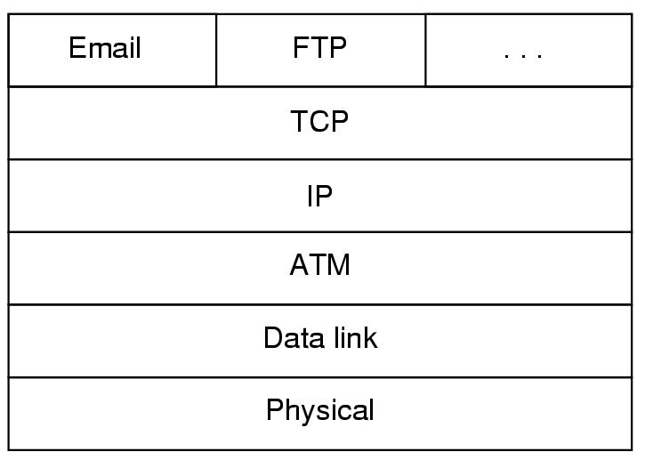
Design issues: services
Network
Layer
Network layer -- May 2004
Notes:
4. Network Layer - routing
February 2006
Computer Networks

Slide 9

Design: internal organisation
Virtual circuits
  Routes chosen at connection time
  Connection identified by a virtual circuit number (VCn)
  Primary service of subnet is connection-oriented
4
Transport
7
Transport
Network
Network
Data Link
Data Link
Physical
Physical
Routing problem: map
[Incoming line, VCn]
➔[outgoing line, VCn]
Network layer -- May 2004

Slide 10

Design: internal organisation
Virtual circuits
Network layer -- May 2004

Slide 11
Design: internal organisation
Datagram subnet
  Each packet is routed independently
  Subnet has more work to do
  More robust, easier to adapt to failures and congestion
Transport
Transport
Network
Network
Data Link
Data Link
Physical
Physical
Routing problem: map
Destination address
➔ Outgoing line
Network layer -- May 2004

Slide 12

Design: internal organisation
Datagram subnet
Network layer -- May 2004

Slide 13
Design: internal organisation
Datagram subnet
Change of routing table
Network layer -- May 2004

Slide 14
Design: internal organisation
Issue | Datagram subnet | VC subnet
Circuit setup | Not needed | required
Addressing | Full addresses (source + destination) in each packet | Short VC number in each packet
State information | No state held in subnet | State held for each VC
Routing | Done for each packet independently | Route chosen at connection setup
Effect of router failures | None, except for packet losses | All VCs passing failed router are terminated
Congestion control | difficult | Easy if enough buffers can be allocated in advance
Network layer -- May 2004

Slide 15
Design: internal organisation
 | Type of | subnet
Service to upper layer | Datagram | Virtual Circuit
Connectionless | UDP IP | UDP IP ATM
Connection-oriented | TCP IP | ATM AAL1 ATM
Network layer -- May 2004

Slide 16
Network Layer
Design issues
Routing
Congestion
Internetworking
Internet Protocols
Multimedia or Qos
Network layer -- May 2004
Notes:
4. Network Layer - routing
February 2006
Computer Networks

Slide 17
Routing Algorithms
Properties
Shortest Path Routing
Flooding
Distance Vector Routing
Link State routing
Hierarchical routing
Broadcast routing
Multicast routing
Routing for mobile hosts
Routing in Ad Hoc Networks
Node Lookup in Peer-to-Peer Networks
Most important algorithms!
Network layer -- May 2004

Slide 18
Routing algorithms
Desirable properties
  Correctness
  Simplicity
  Robustness: able to cope with
    changes in topology, load
    hardware and software failures
  Stability
    Converge to equilibrium
  Fairness
  Optimality
}
all algorithms
⎫⎬⎭
hard to achieve
}
conflicting
Network layer -- May 2024

Slide 19
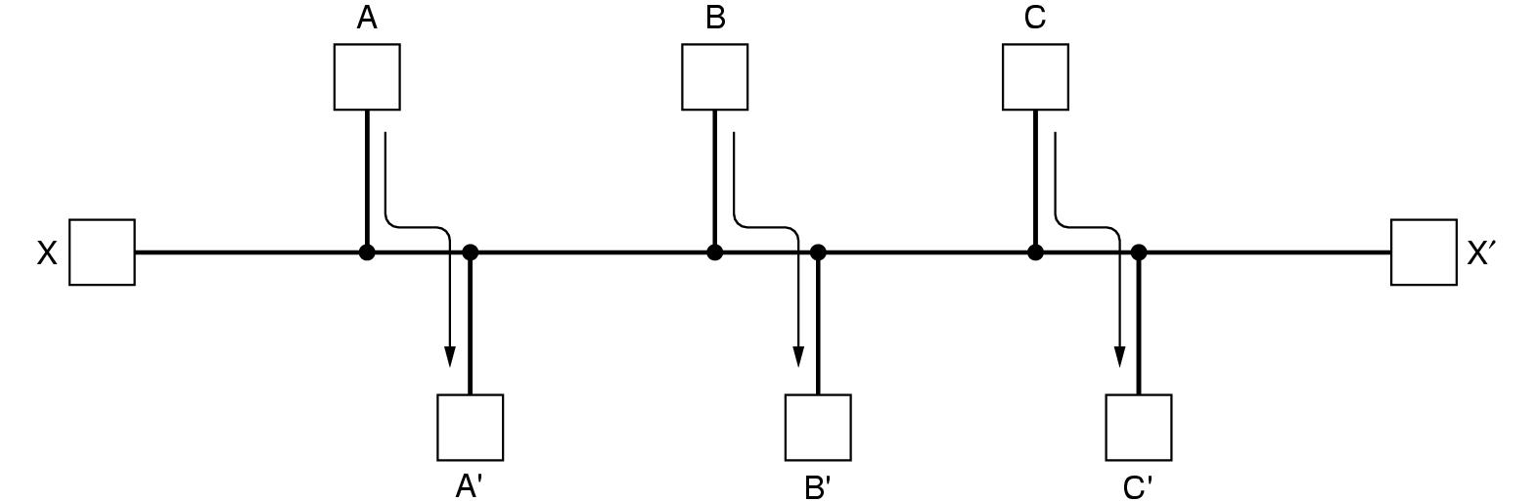
Routing algorithms
Desirable properties (cont.)
  Fairness
  Optimality
Conflict!
Network layer -- May 2004
Notes:
4. Network Layer - routing
February 2006
Computer Networks

Slide 20
Routing algorithms
Taxonomy
  Non adaptive
    Routing decisions computed in advance, off-line and downloaded
  Adaptive
    To changes in
      Topology
      Load
    Get information
      Locally
      From adjacent routers
      From all routers
Network layer -- May 2004
Notes:
4. Network Layer - routing
February 2006
Computer Networks

Slide 21
Routing algorithms
Optimality principle
Optimal path from I to K over J
I 
● K
d₁
distance
d₂
d₁ + d₂ is minimal
J
●
d₃
Other path from J to K
d₃ > d₂
as
d₁ + d₃ > d₁ + d₂
Set of all optimal routes
from all sources
to a given destination
is a tree: sink tree
Network layer -- May 2004
Notes:
4. Network Layer - routing
February 2006
Computer Networks

Slide 22
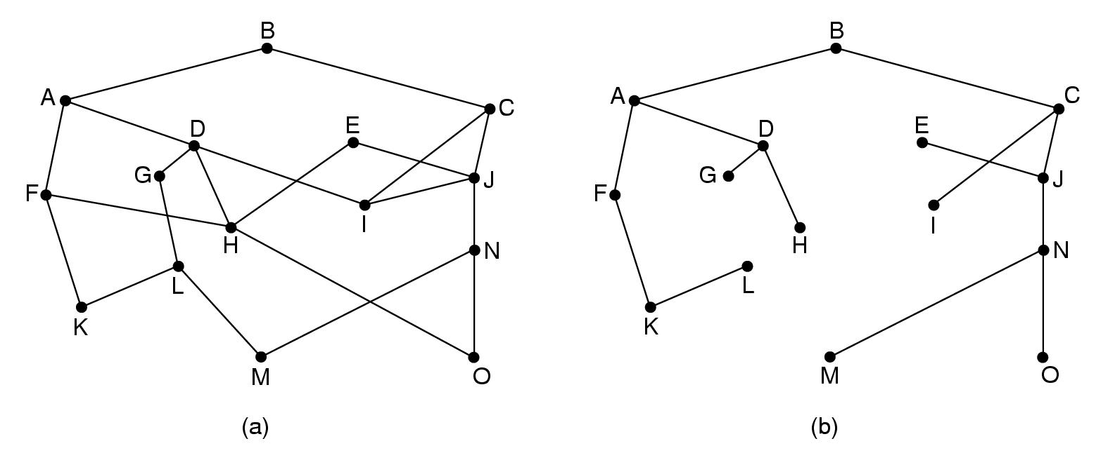
Routing algorithms
Optimality principle: sink tree
Destination
Network layer -- May 2004
Notes:
4. Network Layer - routing
February 2006
Computer Networks

Slide 23
Routing: shortest path
Algorithm of Dijkstra: shortest path in graph
  Graph
    Node = router
    Arc = communication line
  Metric
    Number of hops
    Geographic distance
    Mean queueing and transmission delay
Network layer -- May 2004
Notes:
4. Network Layer - routing
February 2006
Computer Networks

Slide 24
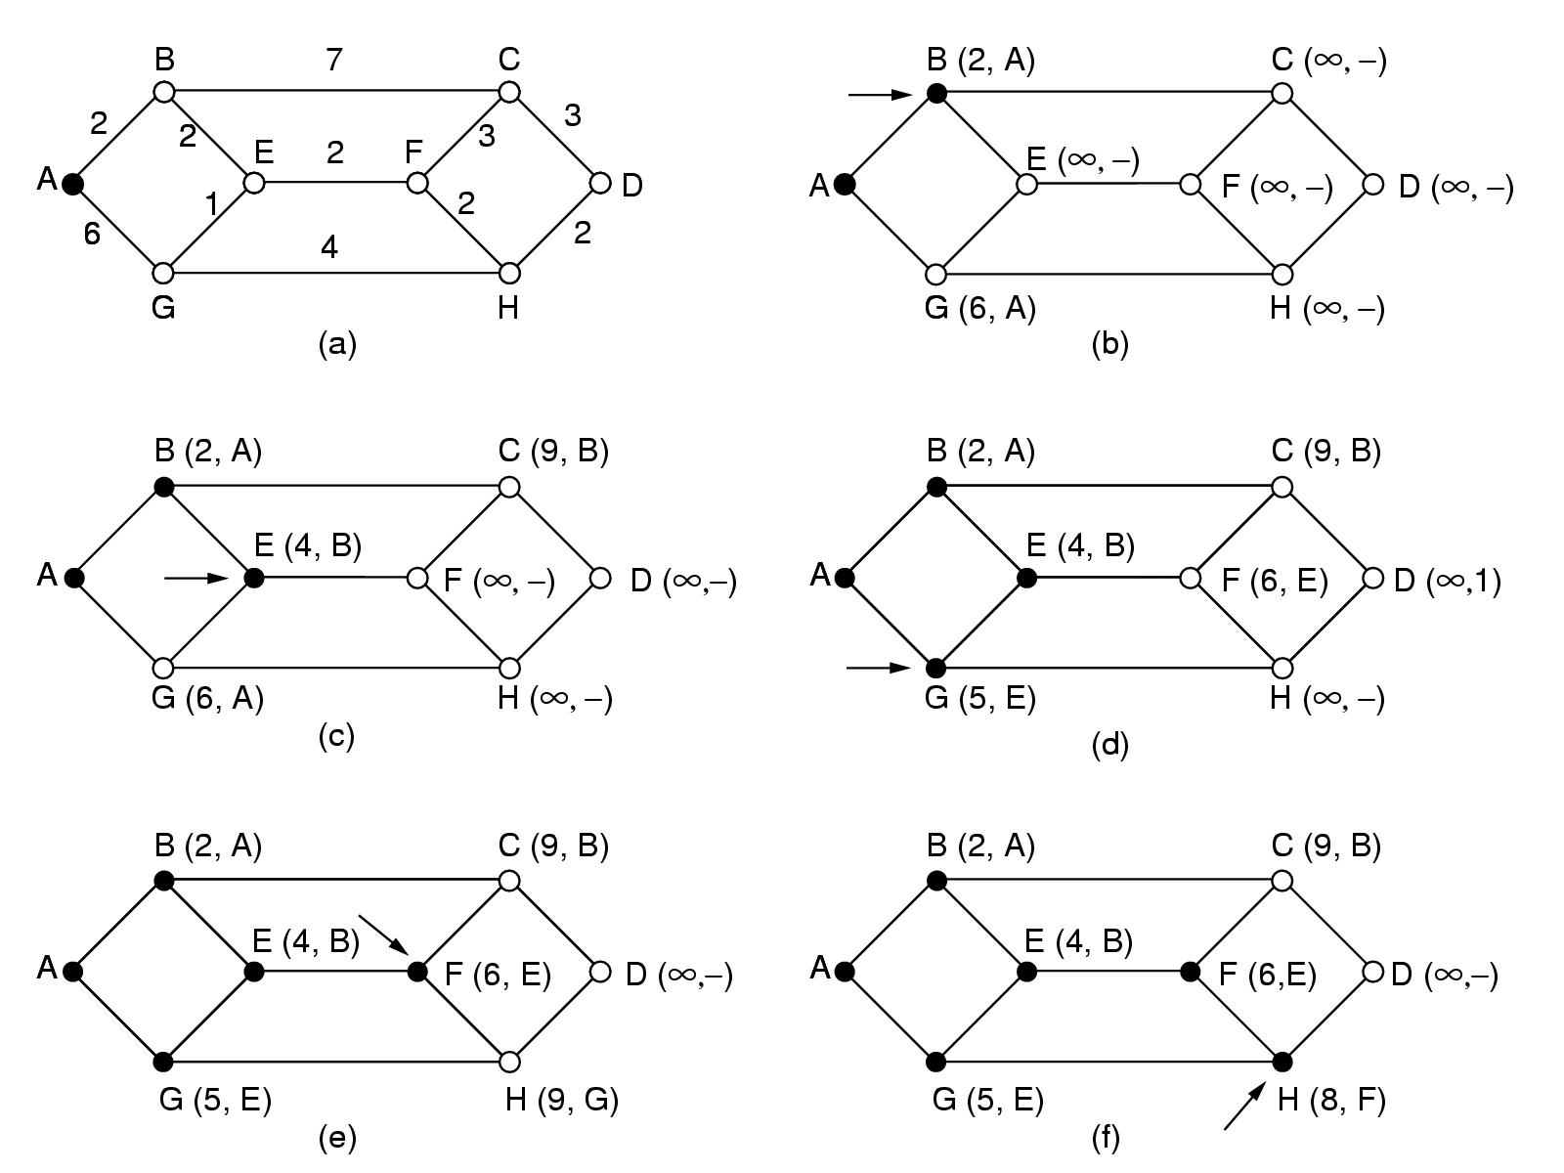
Routing: shortest path
Initial node
Elements of algorithm:
Mark all nodes as free: 
Mark initial node as selected: 
repeat till destination is selected:
  Label all free nodes reachable from selected nodes with shortest distance to a selected node
  Select free node with shortest distance to a selected node and mark it as selected
Network layer -- May 2004
Notes:
4. Network Layer - routing
February 2006
Computer Networks

Slide 25
Routing: shortest path
Network layer -- May 2004
Notes:
4. Network Layer - routing
February 2006
Computer Networks

Slide 26
Routing: flooding
Every packet is sent out on every outgoing line except the one it arrived at
Network layer -- May 2004

Slide 27
Routing: flooding
Every packet is sent out on every outgoing line except the one it arrived at
Network layer -- May 2004

Slide 28
Routing: flooding
Every packet is sent out on every outgoing line except the one it arrived at
Network layer -- May 2004

Slide 29
Routing: flooding
Every packet is sent out on every outgoing line except the one it arrived at
Network layer -- May 2004

Slide 30
Routing: flooding
Every packet is sent out on every outgoing line except the one it arrived at
Duplicates!! How to limit?
  Hop counter
    Decrement in each router
    Discard packet if counter is 0
    Initialisation?
  Sequence number in packet
    Avoid sending the same packet a second time
    Keep in each router per source a list of packets already seen
Useful?
Network layer -- May 2004

Slide 31
Routing: flooding
Every packet is sent out on every outgoing line except the one it arrived at
Sometimes useful
  Robust algorithm: e.g. military applications
  Broadcast
  Comparison purposes: always shortest path
Selective flooding
  Use only those lines that are going approximately in right direction
  Still working?
Network layer -- May 2004

Slide 32
Routing Algorithms
Properties
Shortest Path Routing
Flooding
Distance Vector Routing
Link State routing
Hierarchical routing
Broadcast routing
Multicast routing
Routing for mobile hosts
Routing in Ad Hoc Networks
Node Lookup in Peer-to-Peer Networks
Most important algorithms!
Network layer -- May 2004

Slide 33
Routing: distance vector
Adaptive algorithm
  Exchange of info only with neighbours
Data to be available in each router
  Routing table: per destination
    Distance
    Outgoing line
  Distance to all neighbours
Network layer -- May 2004
Notes:
4. Network Layer - routing
February 2006
Computer Networks

Slide 34
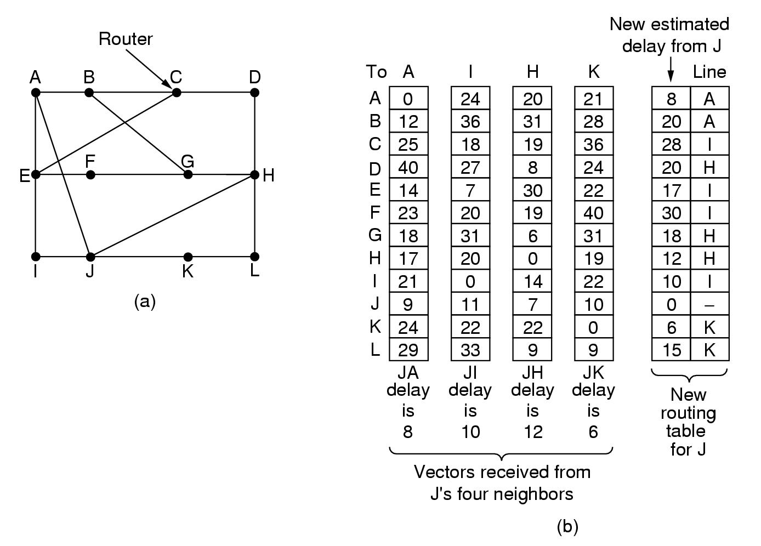
Routing: distance vector
Routing table for A
To | cost | via
A | 0 | -
B | 12 | B
C | 25 | B
D | 40 | B
E | 14 | E
F | 23 | E
G | 18 | B
H | 17 | J
I | 21 | E
J | 9 | J
K | 24 | J
L | 29 | J
Network layer -- May 2004
Notes:
4. Network Layer - routing
February 2006
Computer Networks

Slide 35
Routing: distance vector
Algorithm
  At each step within a router:
    Get routing tables from neighbours
    Compute distance to neighbours
    Compute new routing table
  Characteristics:
    Iterative
    Asynchronous
    Distributed
Network layer -- May 2004

Slide 36
Routing: distance vector
Routing tables from
Network layer -- May 2004
Notes:
4. Network Layer - routing
February 2006
Computer Networks

Slide 37
Routing: distance vector
Better?
Keep 4 tables (one for each neighbour)
Use shortest path
Network layer -- May 2004

Slide 38
Routing: distance vector
Distributed algorithm
  Triggers:
    Change in delay to neighbour
    Receive new table from neighbour
  Update local tables
  If changed: forward routing tables to neighbours
Asynchronous
  Execution in lock step not required
Iterative
  Stops?
How fast are changes propagated?
Good news?
Bad news?
Network layer -- May 2004

Slide 39
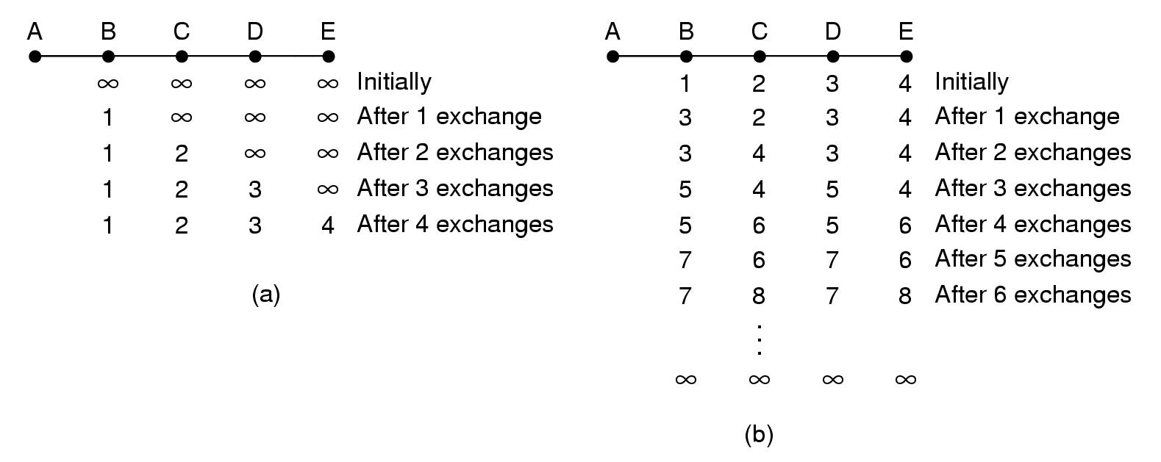
Routing: distance vector
Good news:
A comes up again
Only distances to A
Faster not possible!!!
Network layer -- May 2004
Notes:
4. Network Layer - routing
February 2006
Computer Networks

Slide 40
Routing: distance vector
Bad news:
A goes down
B receives:
Distance ∞ from A
Distance 2 from C
New distance from B to A: 3 via C
Network layer -- May 2004
Notes:
4. Network Layer - routing
February 2006
Computer Networks

Slide 41
Routing: distance vector
Bad news:
A goes down
C still
believes its distance to A is 2
routes via B
B routes its packets for A via C
LOOP!!!
Network layer -- May 2004
Notes:
4. Network Layer - routing
February 2006
Computer Networks

Slide 42
Routing: distance vector
Bad news:
A goes down
Loops!!
Slow!!
∞ = 5?
Network layer -- May 2004
Notes:
4. Network Layer - routing
February 2006
Computer Networks

Slide 43
Routing: distance vector
Split horizon hack:
  Lie to neighbour about distance
  if routing via neighbour
A B C D E
1 2 3 4 initially
∞
∞
lie
∞ 2 3 4 1 iteration
Faster not possible!!
∞ ∞ 3 4 2 iterations
∞ ∞ ∞ 4 3 iterations
Network layer -- May 2004
Notes:
4. Network Layer - routing
February 2006
Computer Networks

Slide 44
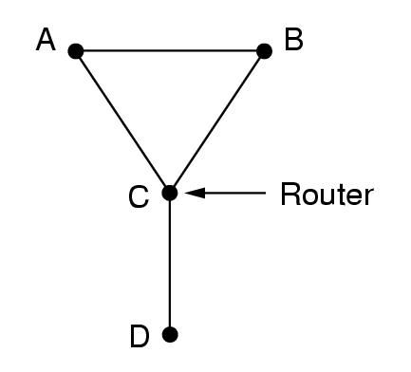
Routing: distance vector
Split horizon hack:
  Hack ➔ does not always work
Example:
  D goes down
  A and B lie to C
  A offers to B route to D
  B offers to A route to D
  Loops again!!!
Network layer -- May 2004
Notes:
4. Network Layer - routing
February 2006
Computer Networks

Slide 45
Routing Algorithms
Properties
Shortest Path Routing
Flooding
Distance Vector Routing
Link State routing
Hierarchical routing
Broadcast routing
Multicast routing
Routing for mobile hosts
Routing in Ad Hoc Networks
Node Lookup in Peer-to-Peer Networks
Most important algorithms!
Network layer -- May 2004

Slide 46
Routing: link state
Overview of algorithm:
Each router must
  Discover its neighbours and learn their network addresses
  Measure the delay or cost to each of its neighbours
  Construct a packet with these distances
  Send this packet to all other routers
  Compute the shortest path to every other router
Network layer -- May 2004
Notes:
4. Network Layer - routing
February 2006
Computer Networks

Slide 47
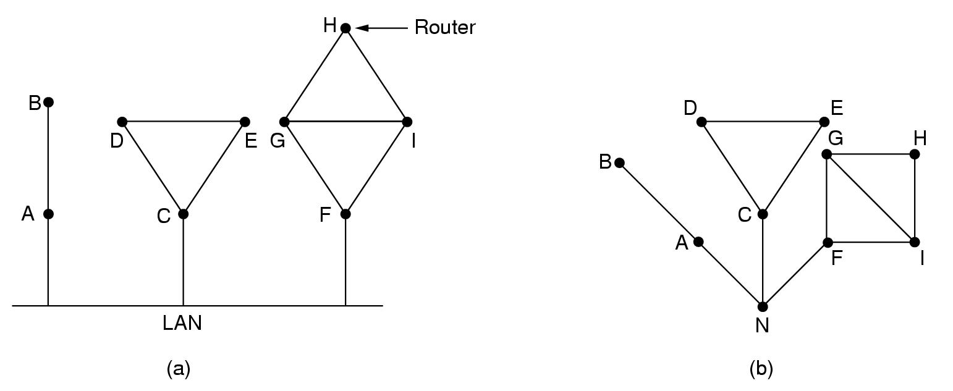
Routing: link state
Algorithm:
Learning about neighbours:
  Upon boot of router
    Send HELLO packet on each point-to-point line
    Routers are supposed to send reply with a globally unique name
  LAN
  model
Network layer -- May 2004
Notes:
4. Network Layer - routing
February 2006
Computer Networks

Slide 48
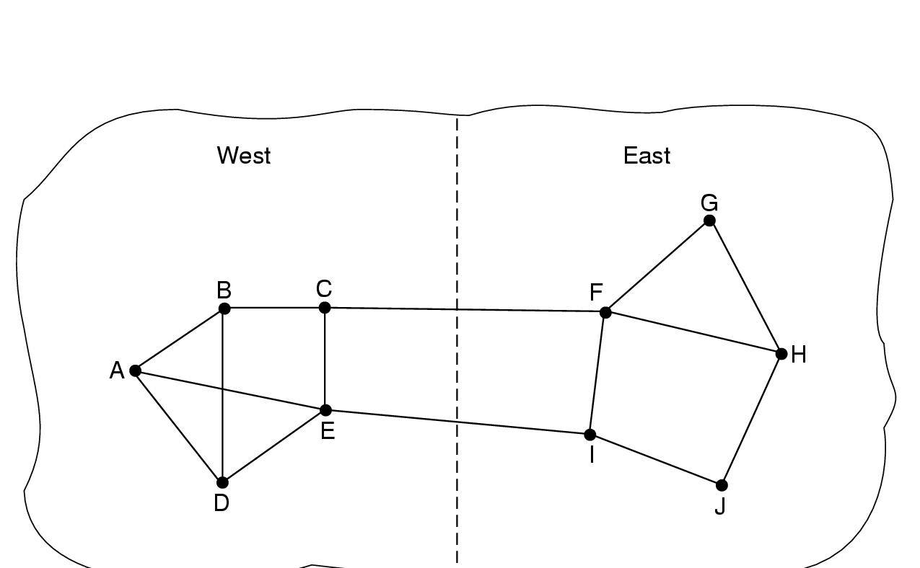
Routing: link state
Algorithm:
Measuring line cost
  Measure round-trip delay of HELLO Packet and its reply
  Take load into account? Arguments both ways:
Yes! preference for unloaded line
No! oscillations are possible
Network layer -- May 2004
Notes:
4. Network Layer - routing
February 2006
Computer Networks

Slide 49
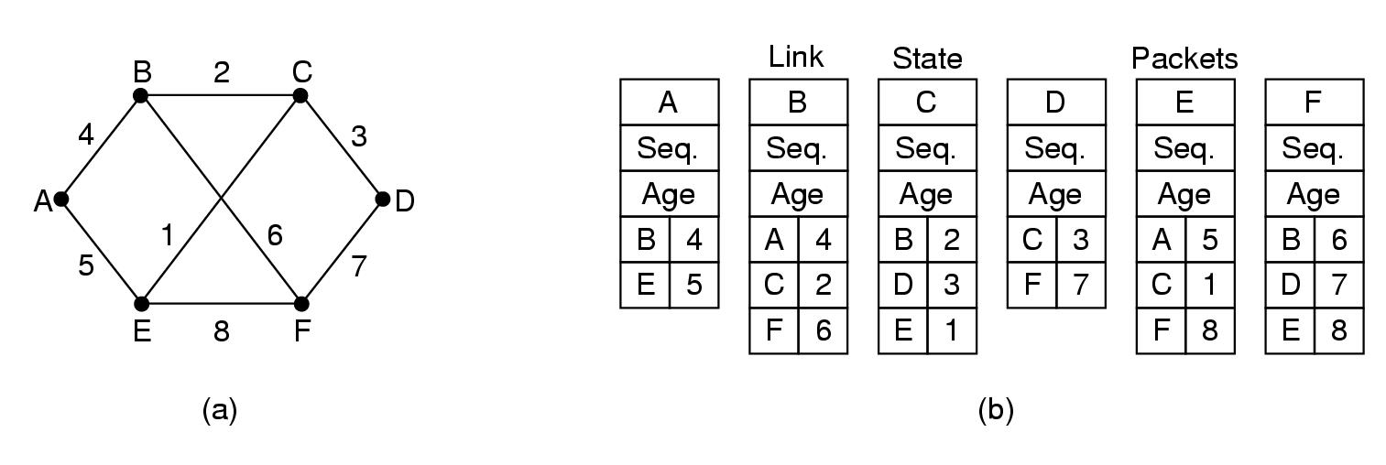
Routing: link state
Algorithm:
Building link state packets
  Packet containing:
    Identity of sender
    Sequence number + age
    For each neighbour: name + distance
When to build?
  periodically
  when significant events occur
Network layer -- May 2004
Notes:
4. Network Layer - routing
February 2006
Computer Networks

Slide 50
Routing: link state
Algorithm:
Distributing link state packets
  Trickiest part of algorithm
    Arrival time for packets different
    How to keep consistent routing tables
  Basic algorithm
    Flooding +
    Sequence number (in each packet) to limit duplicates
  Manageable problems
    Wrap around of sequence numbers:
    Wrong sequence number used:
      lost in case of crash
      Corruption
32 bits + 1 packet/sec ➔ 137 years
Age in each packet:
Decremented during flooding,
while used in router
Age 0 ➔ info discarded
Network layer -- May 2004
Notes:
4. Network Layer - routing
February 2006
Computer Networks

Slide 51
Routing: link state
Algorithm:
Distributing link state packets
  Basic algorithm
  Manageable problems
  Refinements
    Link state packets are not forwarded immediately
    During holding time:
      duplicates are discarded
      Old packets are thrown out
Network layer -- May 2004
Notes:
4. Network Layer - routing
February 2006
Computer Networks

Slide 52
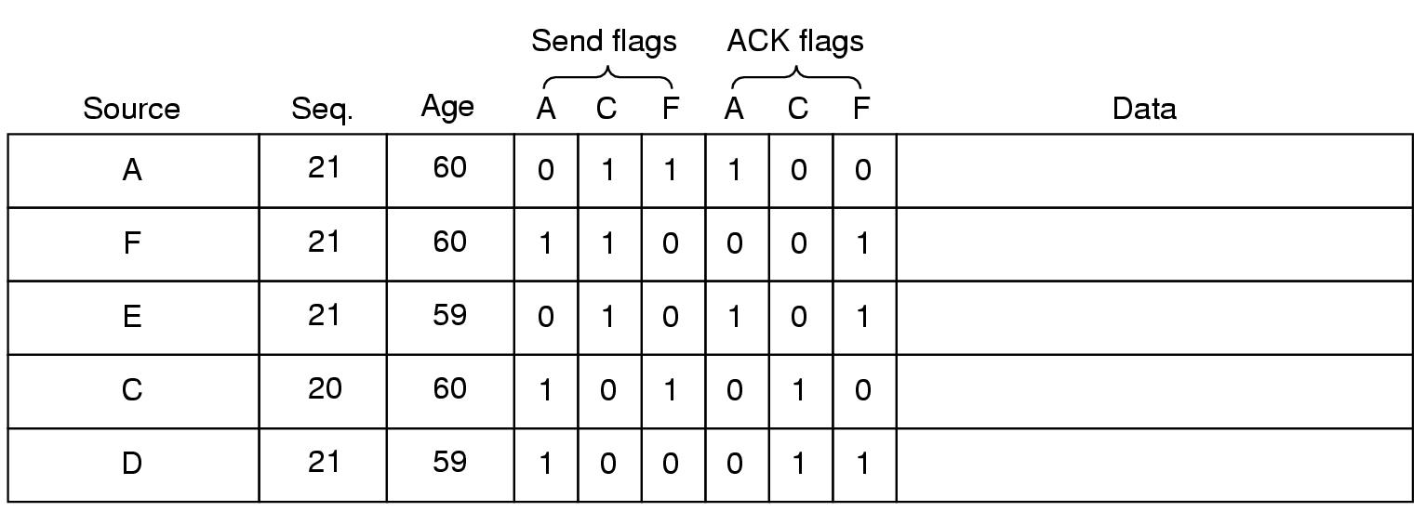
Network Layer
Packet buffer for router B
ACK flag: ACK to send
Send flag: packet to forward
Network layer -- May 2004
Notes:
4. Network Layer - routing
February 2006
Computer Networks

Slide 53
Routing: link state
Algorithm:
Computing new routes:
  With a full set of link state packets, a router can:
    Construct the entire subnet graph
    Run Dijkstra’s algorithm to compute the shortest path to each destination
  Problems for large subnets
    Memory to store data
    Compute time
Network layer -- May 2004
Notes:
4. Network Layer - routing
February 2006
Computer Networks

Slide 54
Routing: link state
Usage:
  IS-IS protocol
    Designed for DECnet, adopted by ISO
    In use also in Internet
    Supports multiple network layer protocols
  OSPF protocol used in Internet
  Common features:
    Self-stabilizing method of flooding link state updates
    Concept of a designated router on a LAN
    Method of computing and supporting path splitting and multiple metrics
Network layer -- May 2004
Notes:
4. Network Layer - routing
February 2006
Computer Networks

Slide 55
Routing Algorithms
Properties
Shortest Path Routing
Flooding
Distance Vector Routing
Link State routing
Hierarchical routing
Broadcast routing
Multicast routing
Routing for mobile hosts
Routing in Ad Hoc Networks
Node Lookup in Peer-to-Peer Networks
Network layer -- May 2004

Slide 56
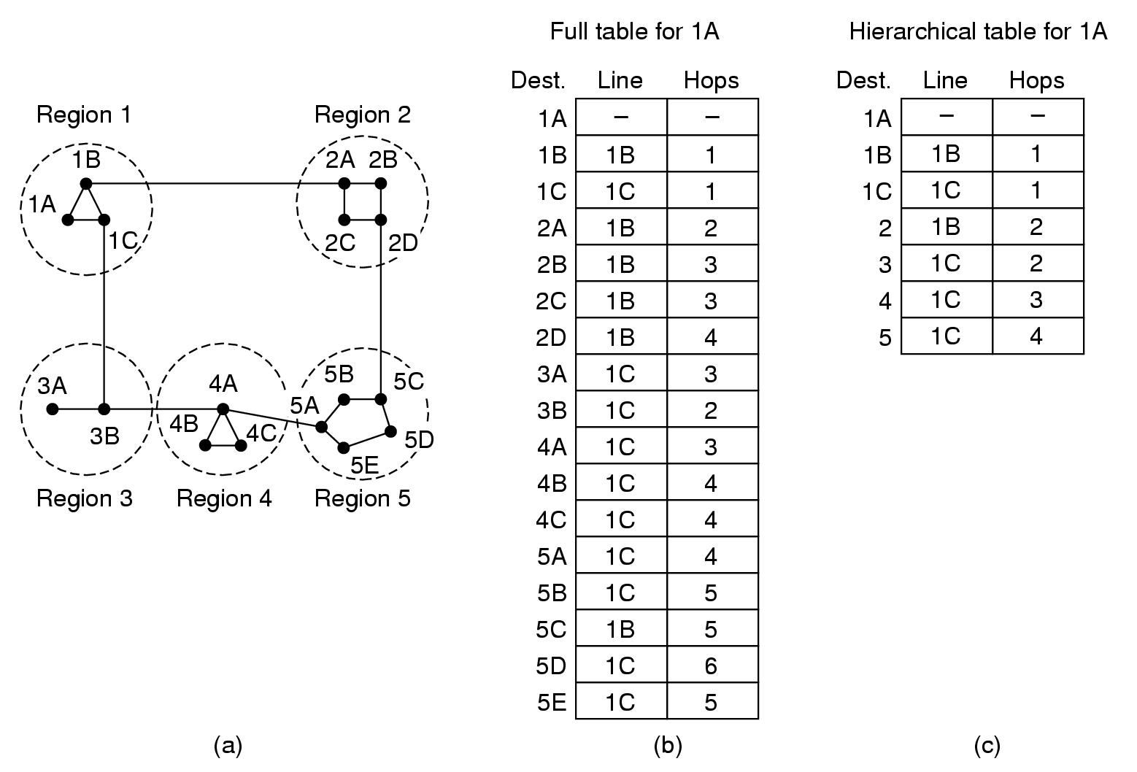
Hierarchical routing
When network size increases…
  Larger stables
  More CPU time needed to compute …
  More bandwidth needed
Network layer -- May 2004

Slide 57
Hierarchical routing
Solution?
Network layer -- May 2004

Slide 58
Hierarchical routing
Routers grouped in regions
Each routers knows how to reach:
  Other routers in its own group
  Other regions
Smaller tables
Longer paths
Network layer -- May 2004

Slide 59
Routing Algorithms
Properties
Shortest Path Routing
Flooding
Distance Vector Routing
Link State routing
Hierarchical routing
Broadcast routing
Multicast routing
Routing for mobile hosts
Routing in Ad Hoc Networks
Node Lookup in Peer-to-Peer Networks
Network layer -- May 2004

Slide 60
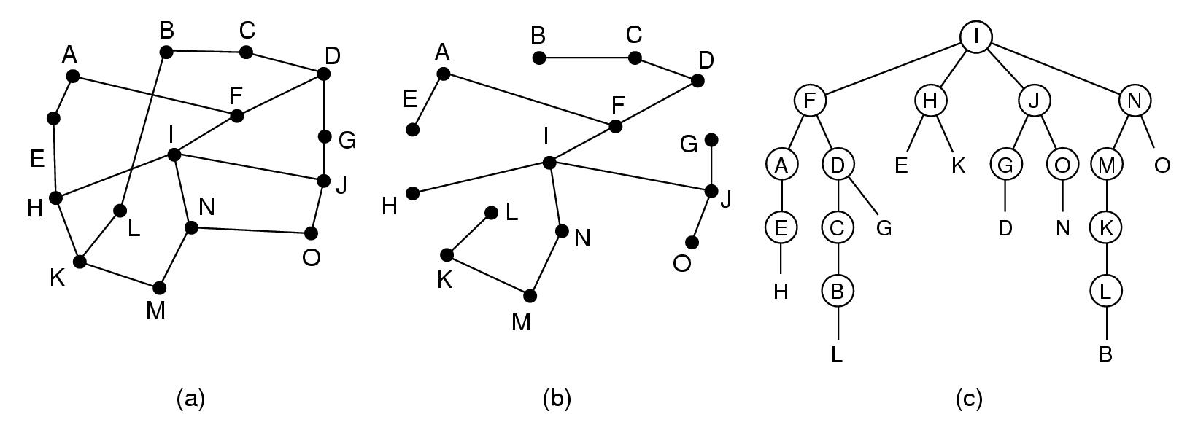
Broadcast routing
Send message to all other hosts:
  Update distributed database
  Distribute weather reports
  Distribute live radio/TV programs
Poor methods:
  Send a distinct packet to each destination
    List of addresses needed
    High usage of bandwidth
  Flooding
    Too many packets
  Multidestination routing
    Each packet contains a list of destination
    On each line a single packet
Network layer -- May 2004

Slide 61
Broadcast routing
Best method: use sink tree
Broadcast source =
root of sink tree
Forwarding on sink tree lines
Excellent use of bandwidth
Source tree must be known at each intermediate node
Which sink tree?
How many sink trees?
Network layer -- May 2004

Slide 62
Broadcast routing
Sink tree approximation: reverse path forwarding
if a packet arrives on line used for traffic to source of broadcast
then forward packet on all lines, except the one it arrived on
else discard packet
Network layer -- May 2004

Slide 63
Routing Algorithms
Properties
Shortest Path Routing
Flooding
Distance Vector Routing
Link State routing
Hierarchical routing
Broadcast routing
Multicast routing
Routing for mobile hosts
Routing in Ad Hoc Networks
Node Lookup in Peer-to-Peer Networks
Network layer -- May 2004

Slide 64
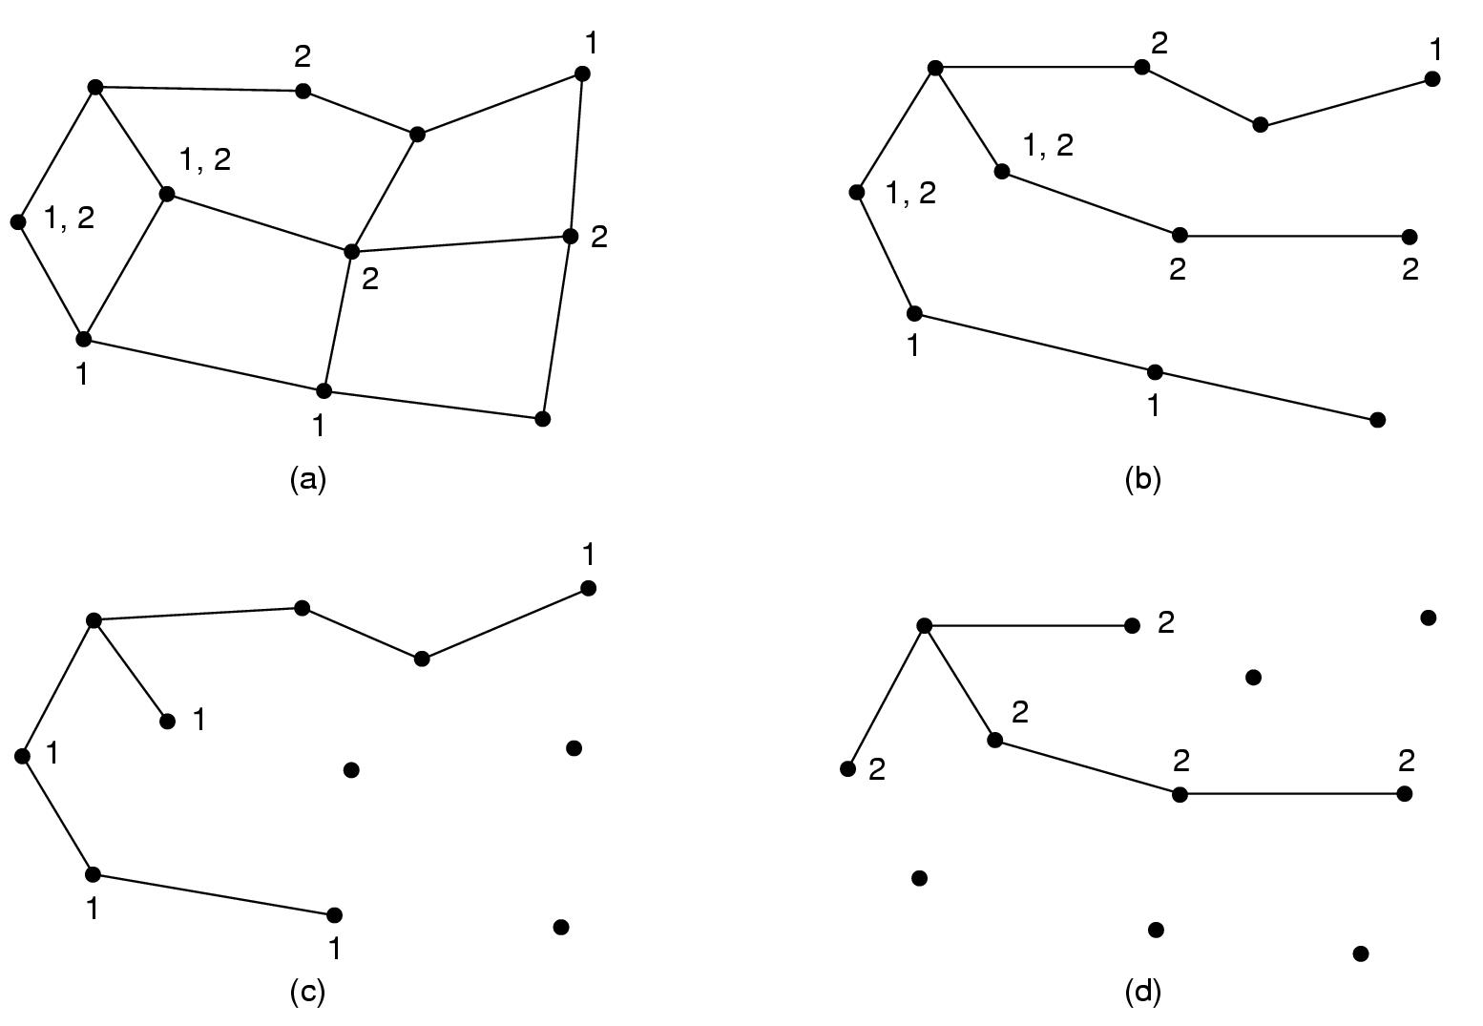
Multicast routing
Send a message to a well-defined group
  Large in size
  Small compared to network as a whole
Group management
  Create and destroy groups
  Process can leave and join a group
algorithm
How will routers know about groups?
Network layer -- May 2004

Slide 65
Multicast routing
source
Algorithm
  Source computes spanning tree
  Remove lines that do not lead to hosts of group
  ( = pruning)
Pruning:
  Link state routing
    Each router knows full topology
  Distance vector routing
    Reverse path forwarding +
    PRUNE messages to remove arcs
Network layer -- May 2004

Slide 66
Multicast routing
source
Pruning:
  Link state routing
    Each router knows full topology
  Distance vector routing
    Reverse path forwarding +
    PRUNE messages to remove arcs
Network layer -- May 2004

Slide 67
Routing Algorithms
Properties
Shortest Path Routing
Flooding
Distance Vector Routing
Link State routing
Hierarchical routing
Broadcast routing
Multicast routing
Routing for mobile hosts
Routing in Ad Hoc Networks
Node Lookup in Peer-to-Peer Networks
Network layer -- May 2004

Slide 68
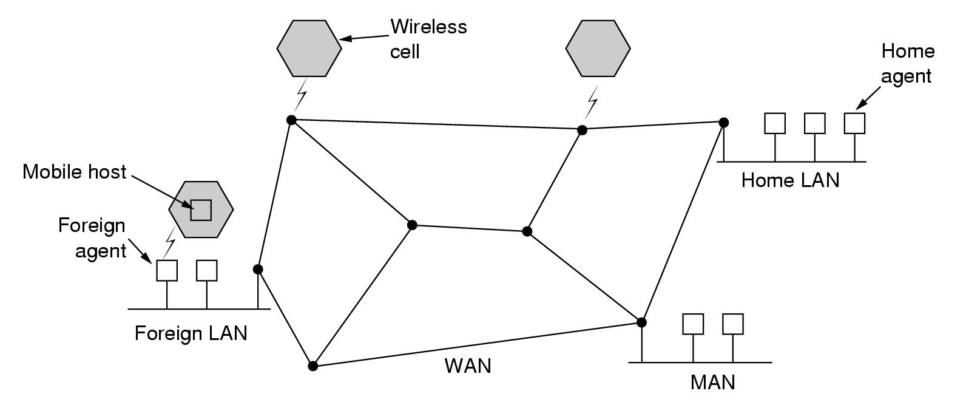
Routing for Mobile Hosts
Model of world: WAN + LANs, wireless cells
Migratory users
Roaming users
Move from time to time
Use network when connected
Compute on the run
Maintain connections as they move around
Network layer -- May 2004
Notes:
4. Network Layer - routing
February 2006
Computer Networks

Slide 69
Routing for Mobile Hosts
Foreign agent: keeps track of users:
  who are currently visiting the area
Home agent: keeps track of users
  whose home is in the area
  who are currently visiting another area
Permanent home location
Permanent home address
Network layer -- May 2004

Slide 70
Routing for Mobile Hosts
How does it work?
  Registration procedure with foreign agents
  Sending packets
  Leaving an area
Registration procedure with foreign agent
  Announcing existence of foreign agent
    Broadcast by foreign agent
    Broadcast query by arriving mobile user
  Mobile user gives to foreign agent
    Home address
    Current data link address
    Security information
  Foreign agent contacts home agent of user
Network layer -- May 2004

Slide 71
Routing for Mobile Hosts
Registration procedure with foreign agent (cont.)
  Announcing existence of foreign agent
  Mobile user gives to foreign agent
  Foreign agent contacts home agent of user
    Identity of user
    Security info
    Network address of foreign agent
  Home agent
    Checks security info
    Sends ack to foreign agent
  Foreign agent
    Stores state
    Informs mobile user
Network layer -- May 2004

Slide 72
Routing for Mobile Hosts
Sending a packet to a mobile user
  Home address is used ➔ packet routed to home LAN
  Packet intercepted by home agent
   address of user ≠ address of home agent!
  Packet forwarded to the foreign agent
    Encapsulation – tunneling
  Foreign agent forwards packet to mobile user
    Which protocol, address used?
  Sender is given address of foreign agent
    Encapsulation – tunneling used, required?
Network layer -- May 2004

Slide 73
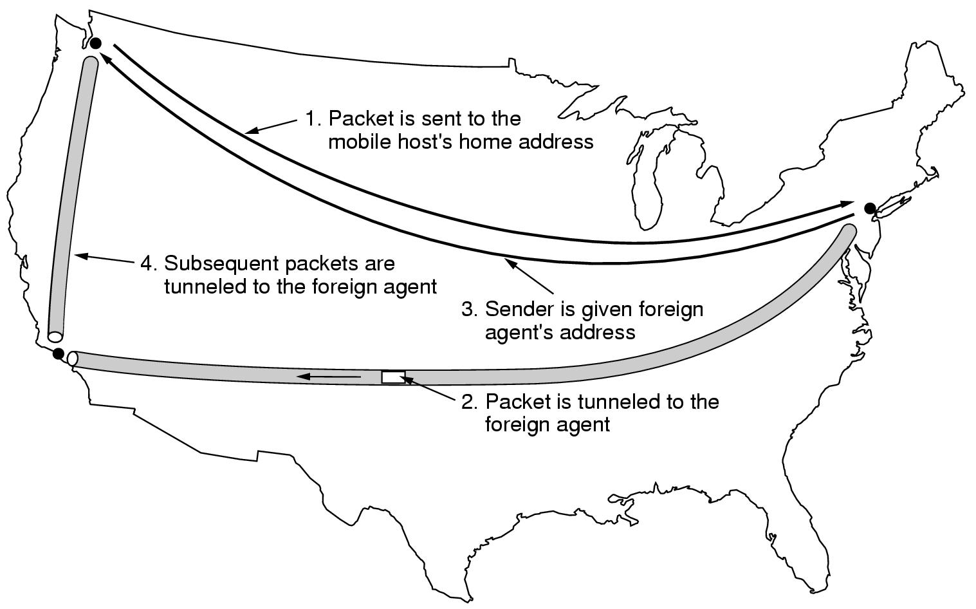
Routing for Mobile Hosts
Home agent
Foreign agent
Network layer -- May 2004
Notes:
4. Network Layer - routing
February 2006
Computer Networks

Slide 74
Routing for Mobile Hosts
Leaving an area
  Announced by user ➔ deregistration
  Automatic detection by foreign agent
Various different schemes:
  Protocol carried out by routers or hosts
  Routers along the way intercept and redirect traffic
  Visitor gets temporary address to off-load foreign agent
  Modify original packet instead of encapsulation
  Security aspects: authentication?
Network layer -- May 2004

Slide 75
Routing Algorithms
Properties
Shortest Path Routing
Flooding
Distance Vector Routing
Link State routing
Hierarchical routing
Broadcast routing
Multicast routing
Routing for mobile hosts
Routing in Ad Hoc Networks
Node Lookup in Peer-to-Peer Networks
Network layer -- May 2004

Slide 76
Routing in Ad Hoc Networks
Ad Hoc Network = routers are mobile
  No fixed topologies
  No fixed or known neighbors
  Valid paths can disappear at any time
  Node = router + host
  Routing quite different from routing in wired networks
Examples
  Military vehicles on a battlefield
  Fleet of ships at see
  People with notebooks (lacking 802.11)
AODV = Ad hoc On-demand distance vector routing
  On-demand: route computed when needed
  Distance vector for mobile world
  Taking into account limited bandwidth + low battery life
Network layer -- May 2004

Slide 77
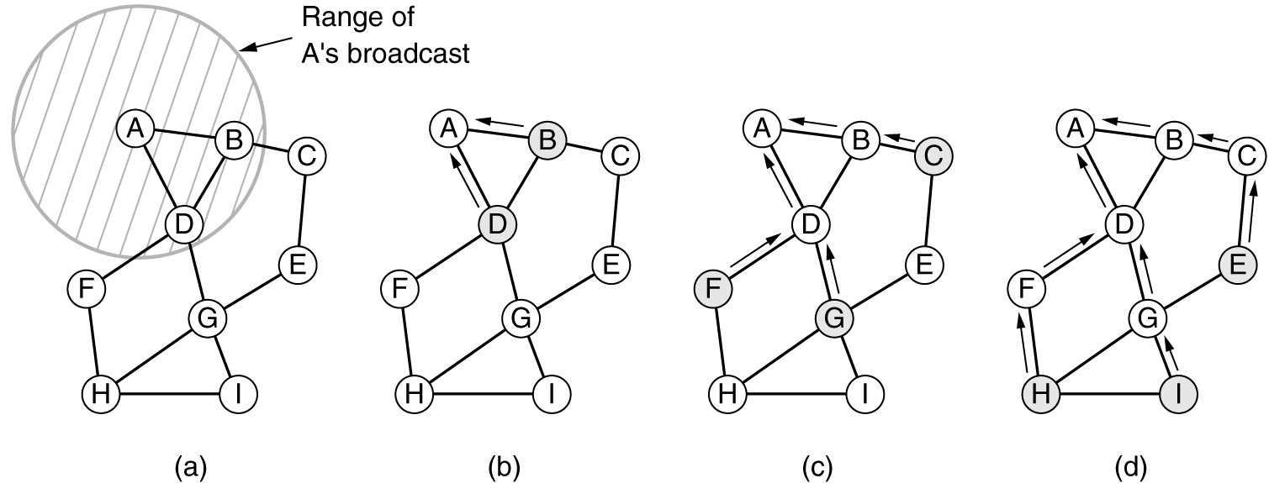
Routing in Ad Hoc Networks
Graph presentation
  Node
  Arc = nodes connected
  can communicate directly by radio
Routing table:
  Line for known routes
  Can be valid or invalid
A wants to send a packet
  To H: forward to D
  To I: start route discovery broadcasting a route request packet
Dest | Next hop | Distance | Other fields
B | B | 1 | …
C | B | 2 | …
H | D | 3 | …
Network layer -- May 2004

Slide 78
Routing in Ad Hoc Networks
Route request packet:
Source & destination address: e.g. IP address
Request ID:
  local counter incremented for each new route request packet broadcasted
  allows to discard duplicate requests at other nodes
Source sequence #
  counter to distinguish old routes to destination from new ones
Destination sequence #
  most recent sequence counter of destination seen by source
Network layer -- May 2004

Slide 79
Routing in Ad Hoc Networks
Processing a route request packet
  duplicate request?
    Yes: discard
  Fresh route to destination known?
    Fresh = local destination sequence # >= destination sequence # in request
    Yes: send route reply packet
  No fresh route to destination is known!
    Store info from route request in reverse route table; to enable the forwarding of route reply packets
    Increment hop count
    Rebroadcast route request
Network layer -- May 2004

Slide 80
Routing in Ad Hoc Networks
Processing a route request packet
  Duplicate request?
  Fresh route to destination known?
  No fresh route to destination is known!
Network layer -- May 2004

Slide 81
Routing in Ad Hoc Networks
Processing a route request packet
  Duplicate request?
  Fresh route to destination known?
  No fresh route to destination is known!
(a) Range of A's broadcast.
(b) After B and D have received A's broadcast.
(c) After C, F, and G have received A's broadcast.
(d) After E, H, and I have received A's broadcast.
Shaded nodes are new recipients. Arrows show possible reverse routes.
Network layer -- May 2004

Slide 82
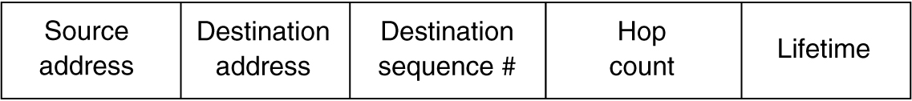
Routing in Ad Hoc Networks
Route reply packet
  Returned by
    Intermediate node knowing a fresh route
    Destination node
Destination sequence#
  Number known by sender of reply packet
Hop count
  Set to length of path known by sender of reply packet
  For destination = 0
Network layer -- May 2004

Slide 83
Routing in Ad Hoc Networks
Route maintenance
  Detect that neighbors are not reachable anymore
    Broadcast Hello packet periodically
    Failure to send packet
  Cleanup routing table
  Additional field in routing table: active neighbor
    Nodes that have offered path to destination in recent past
Network layer -- May 2004

Slide 84
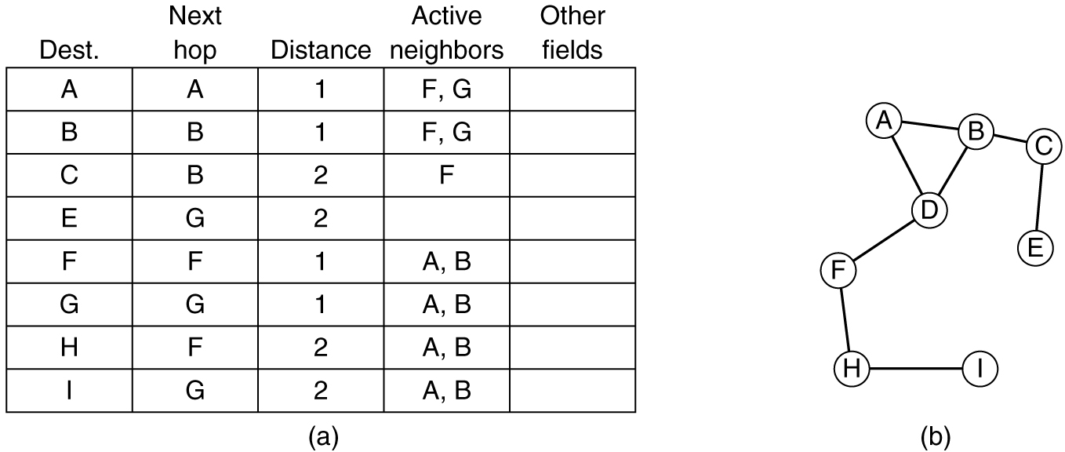
Routing in Ad Hoc Networks
Route maintenance
  Routing table of D
G
Node G goes down!
Network layer -- May 2004

Slide 85
Routing in Ad Hoc Networks
Route maintenance
  New routing table of D:
    Delete routes with G as next hop
    Delete G as active neigbor
Network layer -- May 2004

Slide 86
Routing Algorithms
Properties
Shortest Path Routing
Flooding
Distance Vector Routing
Link State routing
Hierarchical routing
Broadcast routing
Multicast routing
Routing for mobile hosts
Routing in Ad Hoc Networks
Node Lookup in Peer-to-Peer Networks
Network layer -- May 2004

Slide 87
Peer-to-Peer Networks
Peer-to-Peer network
  Large number of users
  Usually permanent wired connections
  In contact to share resources
Interesting features
  Totally distributed
  Symmetric
  No central control or hierarchy
  Users will not know each other
  Users will not know where to find what they are looking for
How can a user find a node that contains the info he is looking for, in the absence of a centralized database or even a centralized index?
➔ Distributed storage system!
Routing?
Network layer -- May 2004

Slide 88
Computer Networks
Network layer
Network layer -- May 2004
Notes:
4. Network Layer - routing
February 2006
Computer Networks

